Slide 1



1
02
Software
Process
Models

Slide 2
2
Today’s
Lesson
A Generic
Process
Model
Prescriptive
Models

Slide 3
3
Process Model Recap
§ A process was defined as a collection of work activities, actions,
and tasks that are performed when some work product is to be created.
§ Each of these activities, actions, and tasks reside within a
framework or model that defines their relationship with the process and with one another.

Slide 4
4
z
Process Model Recap
Five framework activities
§ Communication
§ Planning
§ Modelling
Some umbrella activities
Project tracking and control
§
§
Risk management
Quality assurance
§
§ Construction
§
Configuration management
§ Deployment
§
Technical reviews

Slide 5
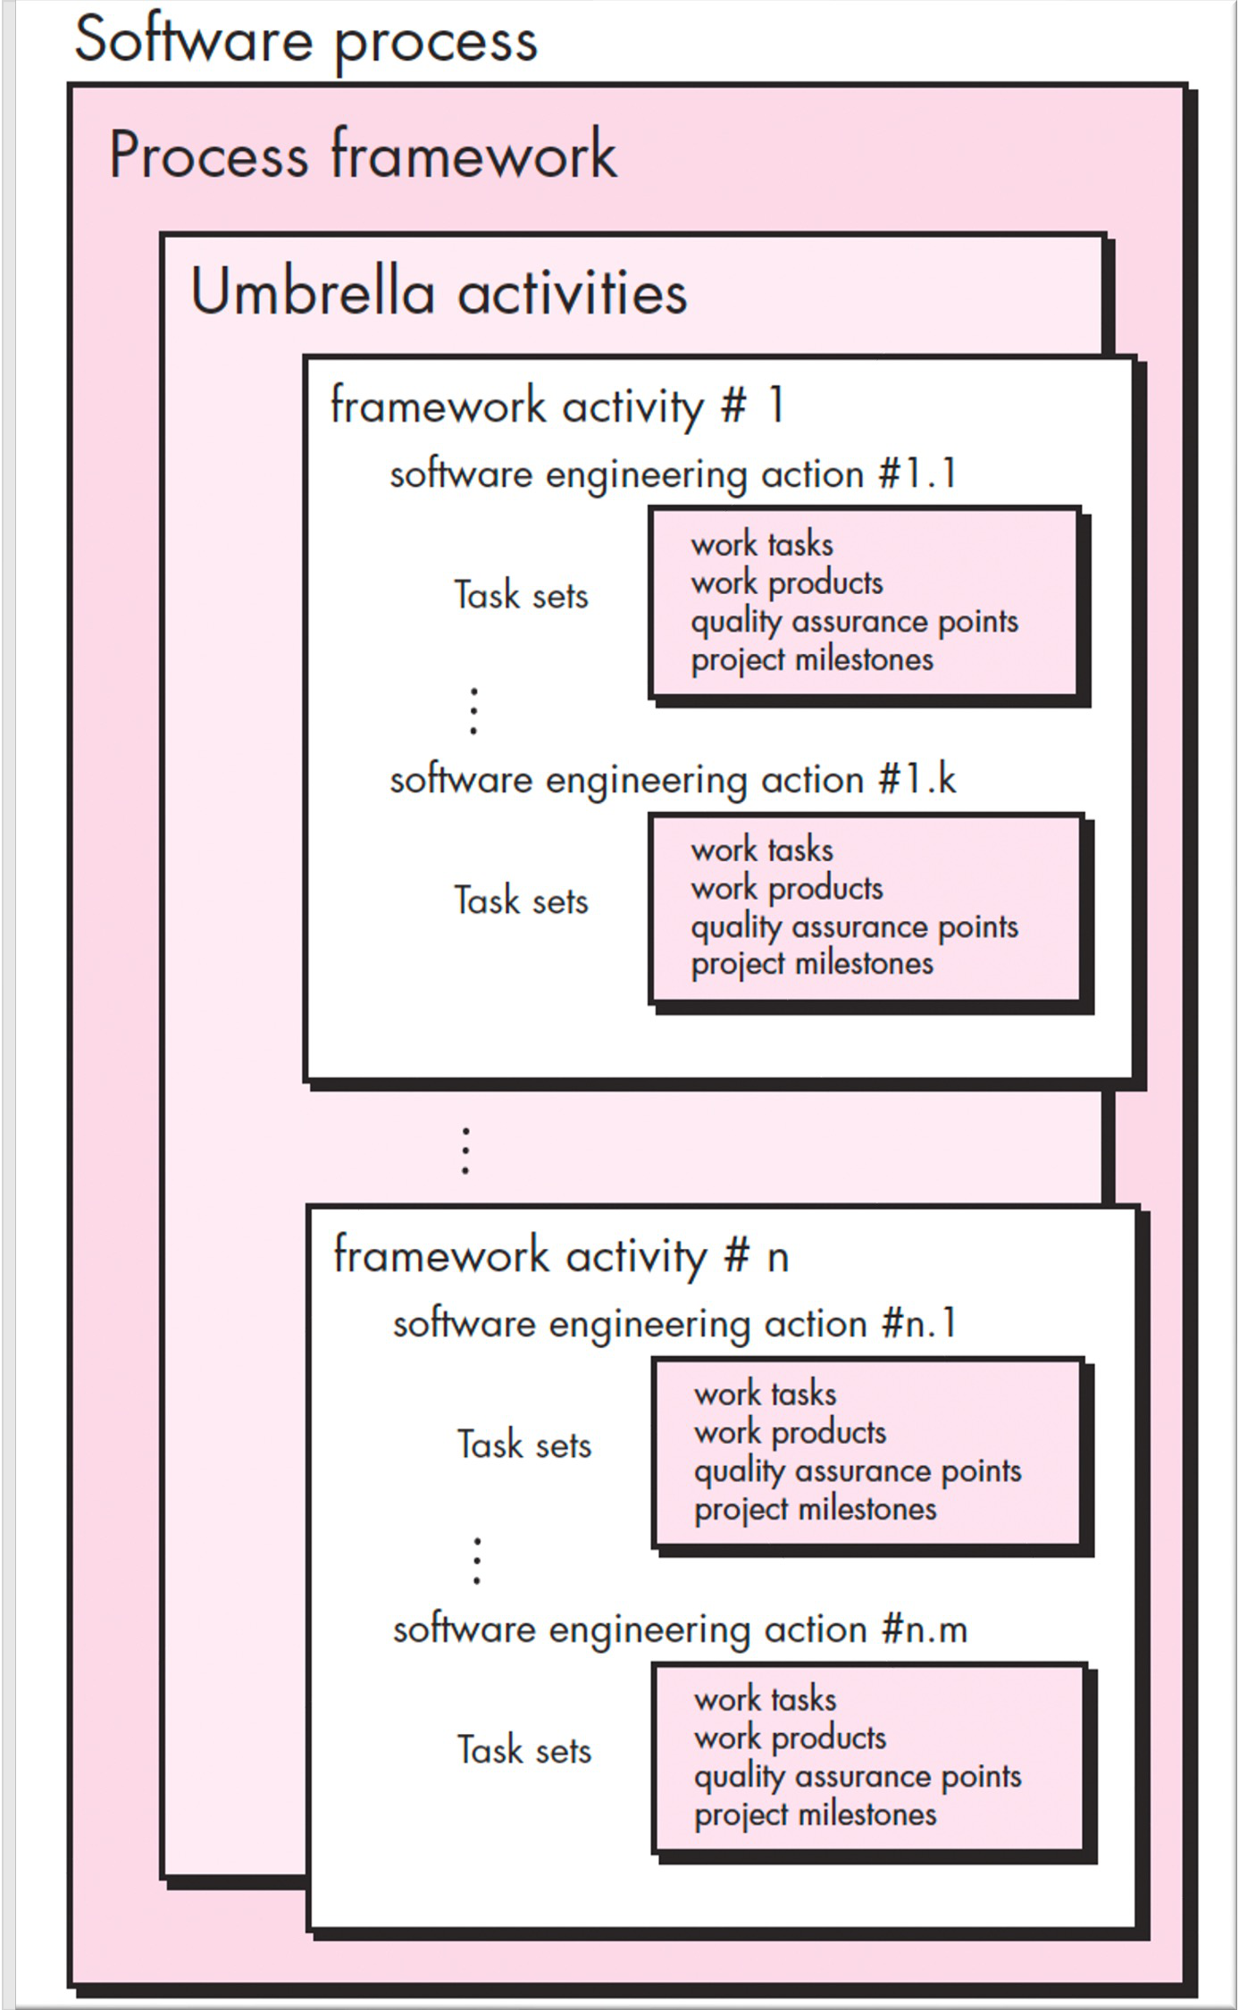
5
z
A Generic Process
Model
Each framework activity is populated by a set
of software engineering actions.
Each software engineering action is defined by a task set that identifies:
• The work tasks that are to be completed
• The work products that will be produced
The quality assurance points that will be required
The milestones that will be used to indicate progress

Slide 6
6
z
The Process Flow
§ The process flow describes how the framework activities and the
actions and tasks that occur within each
organized with respect to sequence and
§ Linear process flow
framework
time
activity
are
§ Iterative process flow
§ Evolutionary process flow
§ Parallel process flow

Slide 7
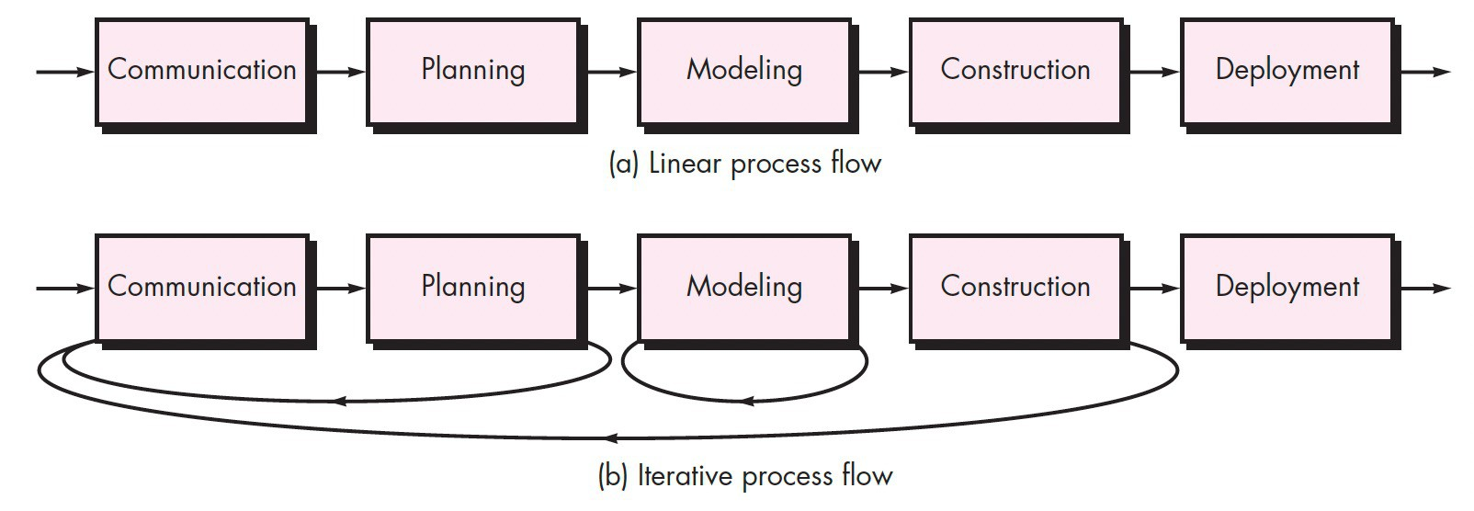
7
z
The Process Flow

Slide 8
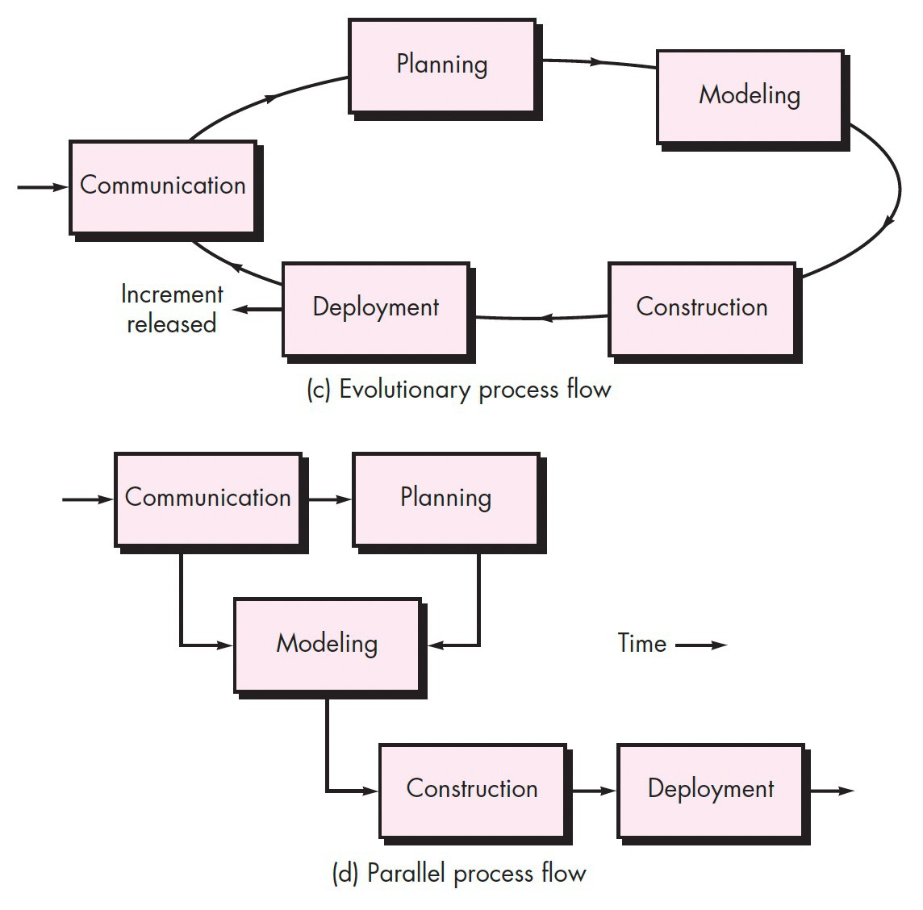
8
z
The Process Flow

Slide 9
9
z
Defining
a
Framework Activity
§ What actions are appropriate for a framework activity, given the
nature of the problem to be solved, the characteristics of the people doing the work, and the stakeholders who are sponsoring the project?

Slide 10
10
z
Defining a Framework Activity
For a small software project requested by one person
simple requirements:
with
Activity
Communication
Phone Call
Action
•
•
•
Make contact with stakeholder via telephone
Discuss requirements and take notes
Organize notes into a brief written statement of requirements
E-mail to stakeholder for review and approval.
Tasks
•

Slide 11
11
z
Defining a Framework Activity
§ If the project was considerably more complex with many
stakeholders, each with a different set of requirements, the
communication activity might have six distinct actions:
§ inception, elicitation, elaboration, negotiation, specification, and validation.
§ Each of these actions would have many work tasks and a
number of distinct work products.

Slide 12
12
z
Identifying a Task Set
§ Each software engineering action can be represented by a
number of different task sets – each a collection of work tasks,
related work products, quality assurance points, and project
milestones.
§ A task set that best accommodates the needs of the project and
the characteristics of the team should be chosen.
§ This implies that a software engineering action can be adapted
to the specific needs of the software project and the
characteristics of the project team.

Slide 13
13
z
Prescriptive Process Models
§ Prescriptive process models were originally proposed to bring
order to the chaos of software development.
§ They prescribe a set of process elements—framework activities,
software engineering actions, tasks, work products, quality
assurance, and change control mechanisms for each project.
§ Each process model also prescribes a process flow - that is, the
manner in which the process elements are interrelated to one
another
§ They are sometimes referred to as “traditional” process models

Slide 14
14
z
Prescriptive
Process
Models
§ Waterfall model
§ V-model
§ Incremental model
§ Prototyping model
§ Spiral Model
§ Concurrent Developmental
Model

Slide 15
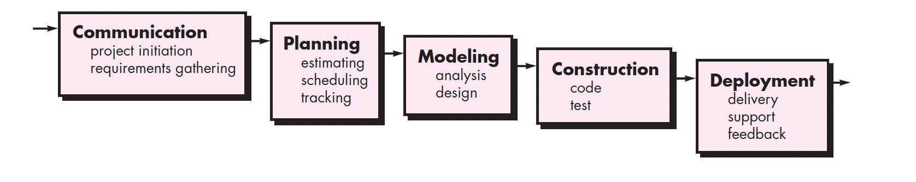
15
z
Waterfall Model
§ The waterfall model, sometimes called the classic life cycle,
suggests a systematic,
development
sequential
approach
to
software
§ What can be some of the downfalls with this
model?

Slide 16
16
z
Waterfall Model
§ There are times when the requirements for a problem are well
understood and work flows in a reasonably linear fashion.
§ Usually, when well-defined adaptations or enhancements to an
existing system must be made
§ It may also occur in a limited number of new development
efforts, but only when requirements are well defined and
reasonably stable.

Slide 17
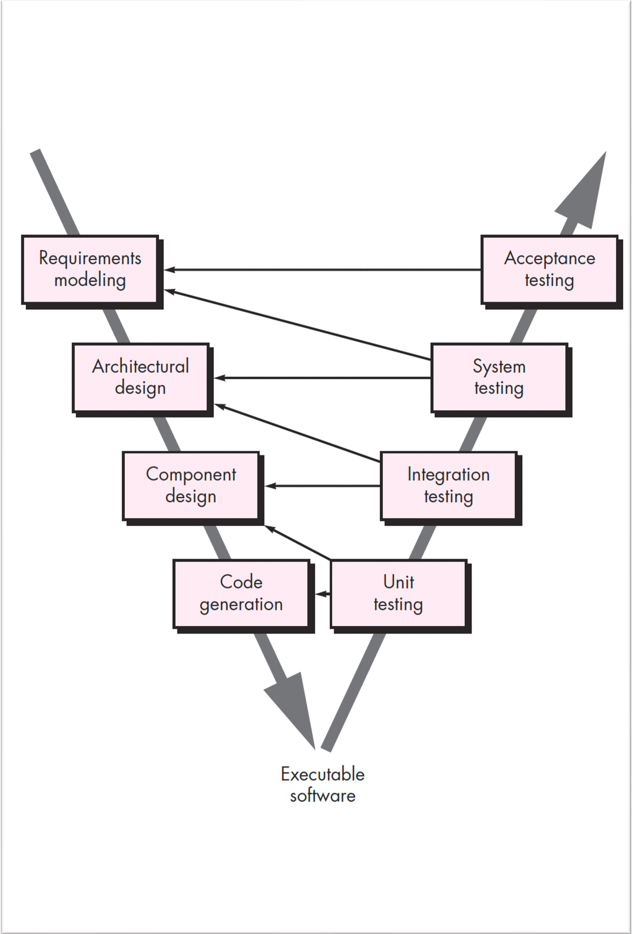
17
z
V
- Model
It is a variation of the waterfall model
§
§
Depicts the relationship of quality
assurance actions to the actions
associated with communication,
modelling, and early construction
activities

Slide 18
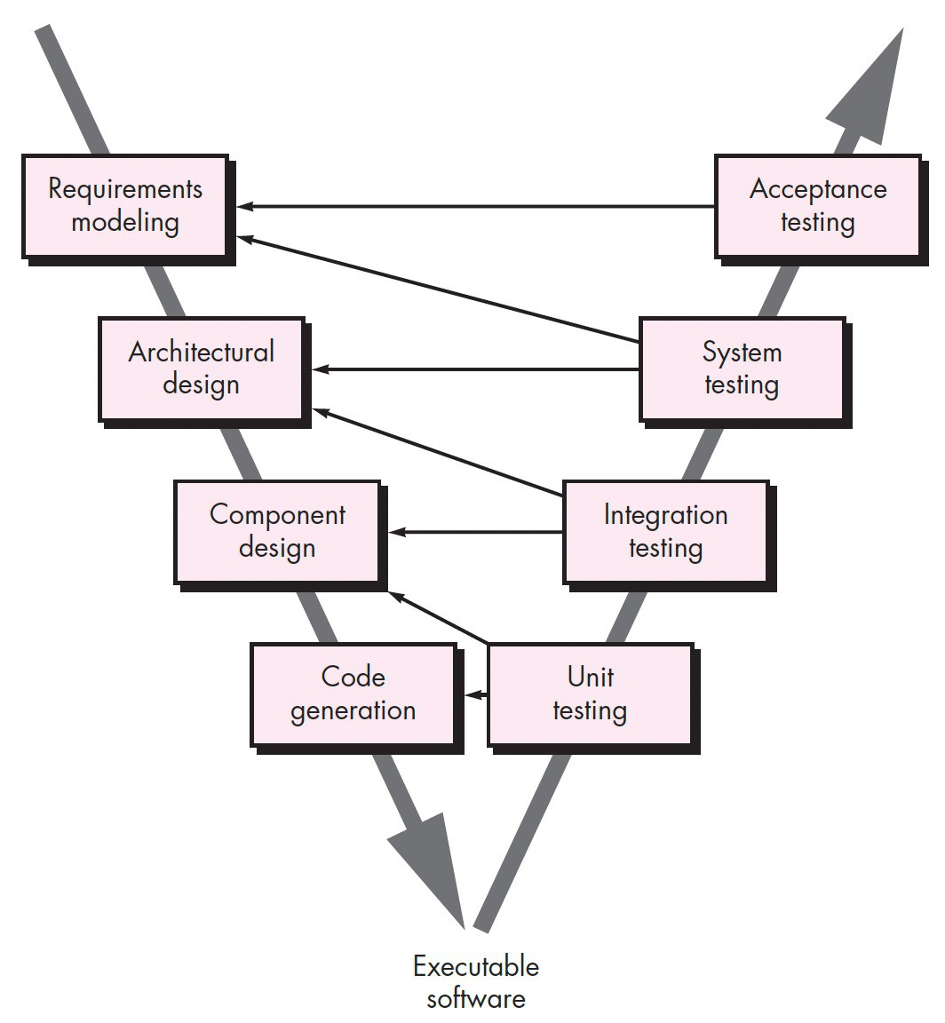
18
z
V - Model
§
Software team starts by moving down
the left side of the V
Once code has been generated, the
team moves up the right side of the V.
Series of tests that validate each of the
models created are validated
The V-model provides a way of
visualizing how verification and
validation actions are applied to earlier
engineering work.
§
§
§

Slide 19
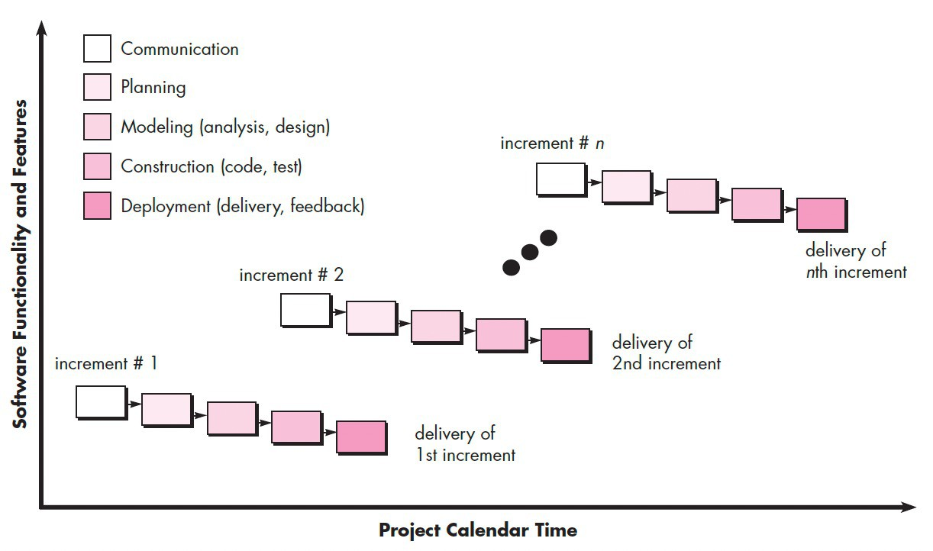
19
z
Incremental
Model
§
This model applies
linear sequences in
a staggered fashion
as calendar time
progresses.
§
Each linear
sequence produces deliverable “increments” of the software

Slide 20
20
z
Incremental Model
§ When an incremental model is used, the first increment is often
a core product.
§ That is, basic requirements are addressed but many
supplementary features remain undelivered.
§ As a result of use and/or evaluation, a plan is developed
next increment
§ This process is repeated following the delivery of each increment, until the complete product is produced.
for the

Slide 21
21
z
Incremental Model
§ There may be well defined initial software requirements, but also
a compelling need to provide a limited set of software
functionality to users quickly and then refine and expand on that
functionality in later software releases.
§ Incremental development is particularly useful when staffing is
unavailable for a complete implementation by the business
deadline that has been established for the project.

Slide 22
22
z
Prototyping Model
§ Often, a customer defines a set of general objectives for
software, but does not identify detailed requirements for functions and features.
§ In other cases, the developer may be unsure of the efficiency of
an algorithm, the adaptability of an operating system, or the form
that human-machine interaction should take.
§ In these, and many other situations, a prototyping paradigm may offer the best approach.

Slide 23
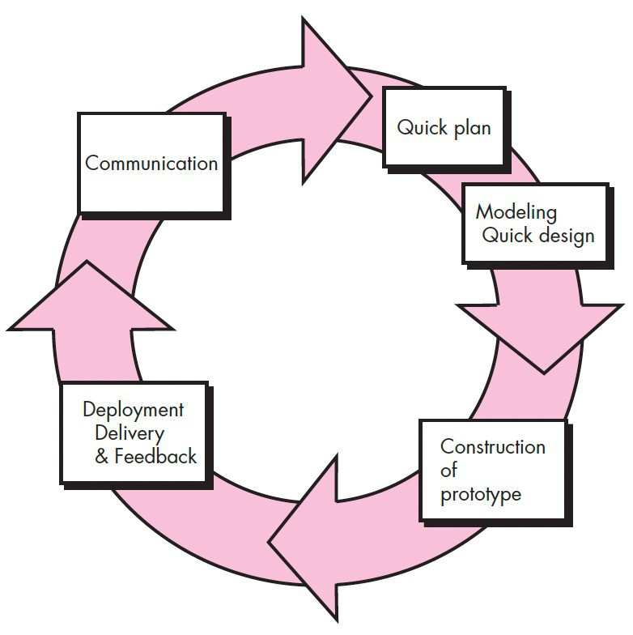
23
z
Prototyping
Model
Iteration occurs as the
prototype is tuned to
satisfy the needs of
various stakeholders,
while at the same time
enabling you to better
understand what needs
to be done.

Slide 24
24
z
Prototyping Model
§ Although prototyping can be used as a stand-alone process
model, it is more commonly used as a technique that can be
implemented within the context of any one of the other process
models.
§ Regardless of the manner in which it is applied, the prototyping
paradigm assists you and other stakeholders to better
understand what is to be built when requirements are fuzzy.
§ What problems can occur with the prototyping model?

Slide 25
25
z
Spiral Model
§ It provides the potential for rapid development of increasingly
more complete versions of the software
§ Software is developed in a series of evolutionary releases.
§ During early iterations, the release might be a model or
prototype.
§ During later iterations, increasingly more complete versions of
the engineered system are produced

Slide 26
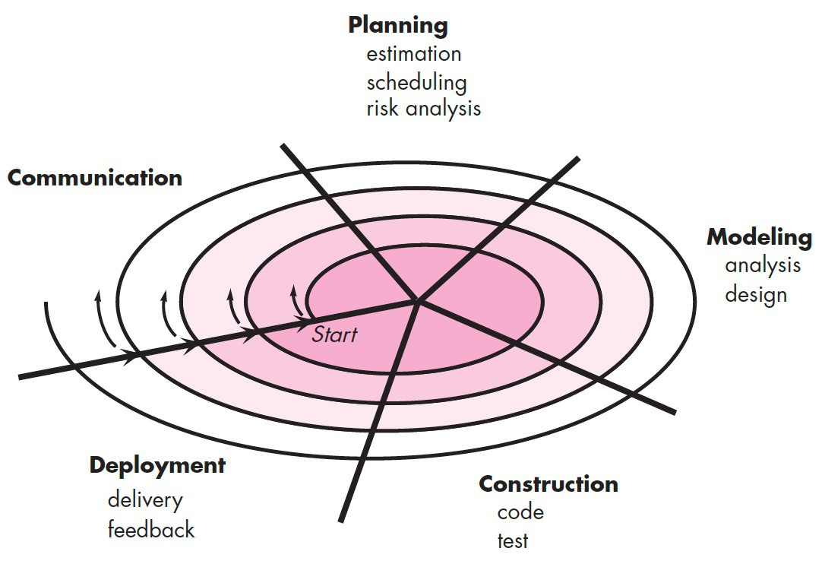
26
z
Spiral Model
§
The first circuit around the spiral
might result in the development of a product specification
§
Subsequent passes might be
used to develop a prototype and
then progressively more
sophisticated versions of the
software.
§
Each pass through the planning
region results in adjustments to the project plan.

Slide 27
27
z
Spiral Model
§ Cost and schedule are
adjusted based on feedback
derived from the customer
after delivery.
§ The project manager adjusts
the planned number of iterations required to complete the software.

Slide 28
28
z
Spiral Model
§
The spiral model is a realistic approach to the development of large-scale
systems and software because software evolves as the process progresses, the
developer and customer better understand and react to risks at each
evolutionary level.
§
It uses prototyping as a risk reduction mechanism but, more important, enables
you to apply the prototyping approach at any stage in the evolution of the product.
§
It maintains the systematic stepwise approach suggested by the classic life cycle
but incorporates it into an iterative framework that more realistically reflects the
real world.
It demands a direct consideration of technical risks at all stages of the project and, if properly applied, should reduce risks before they become problematic.
§

Slide 29
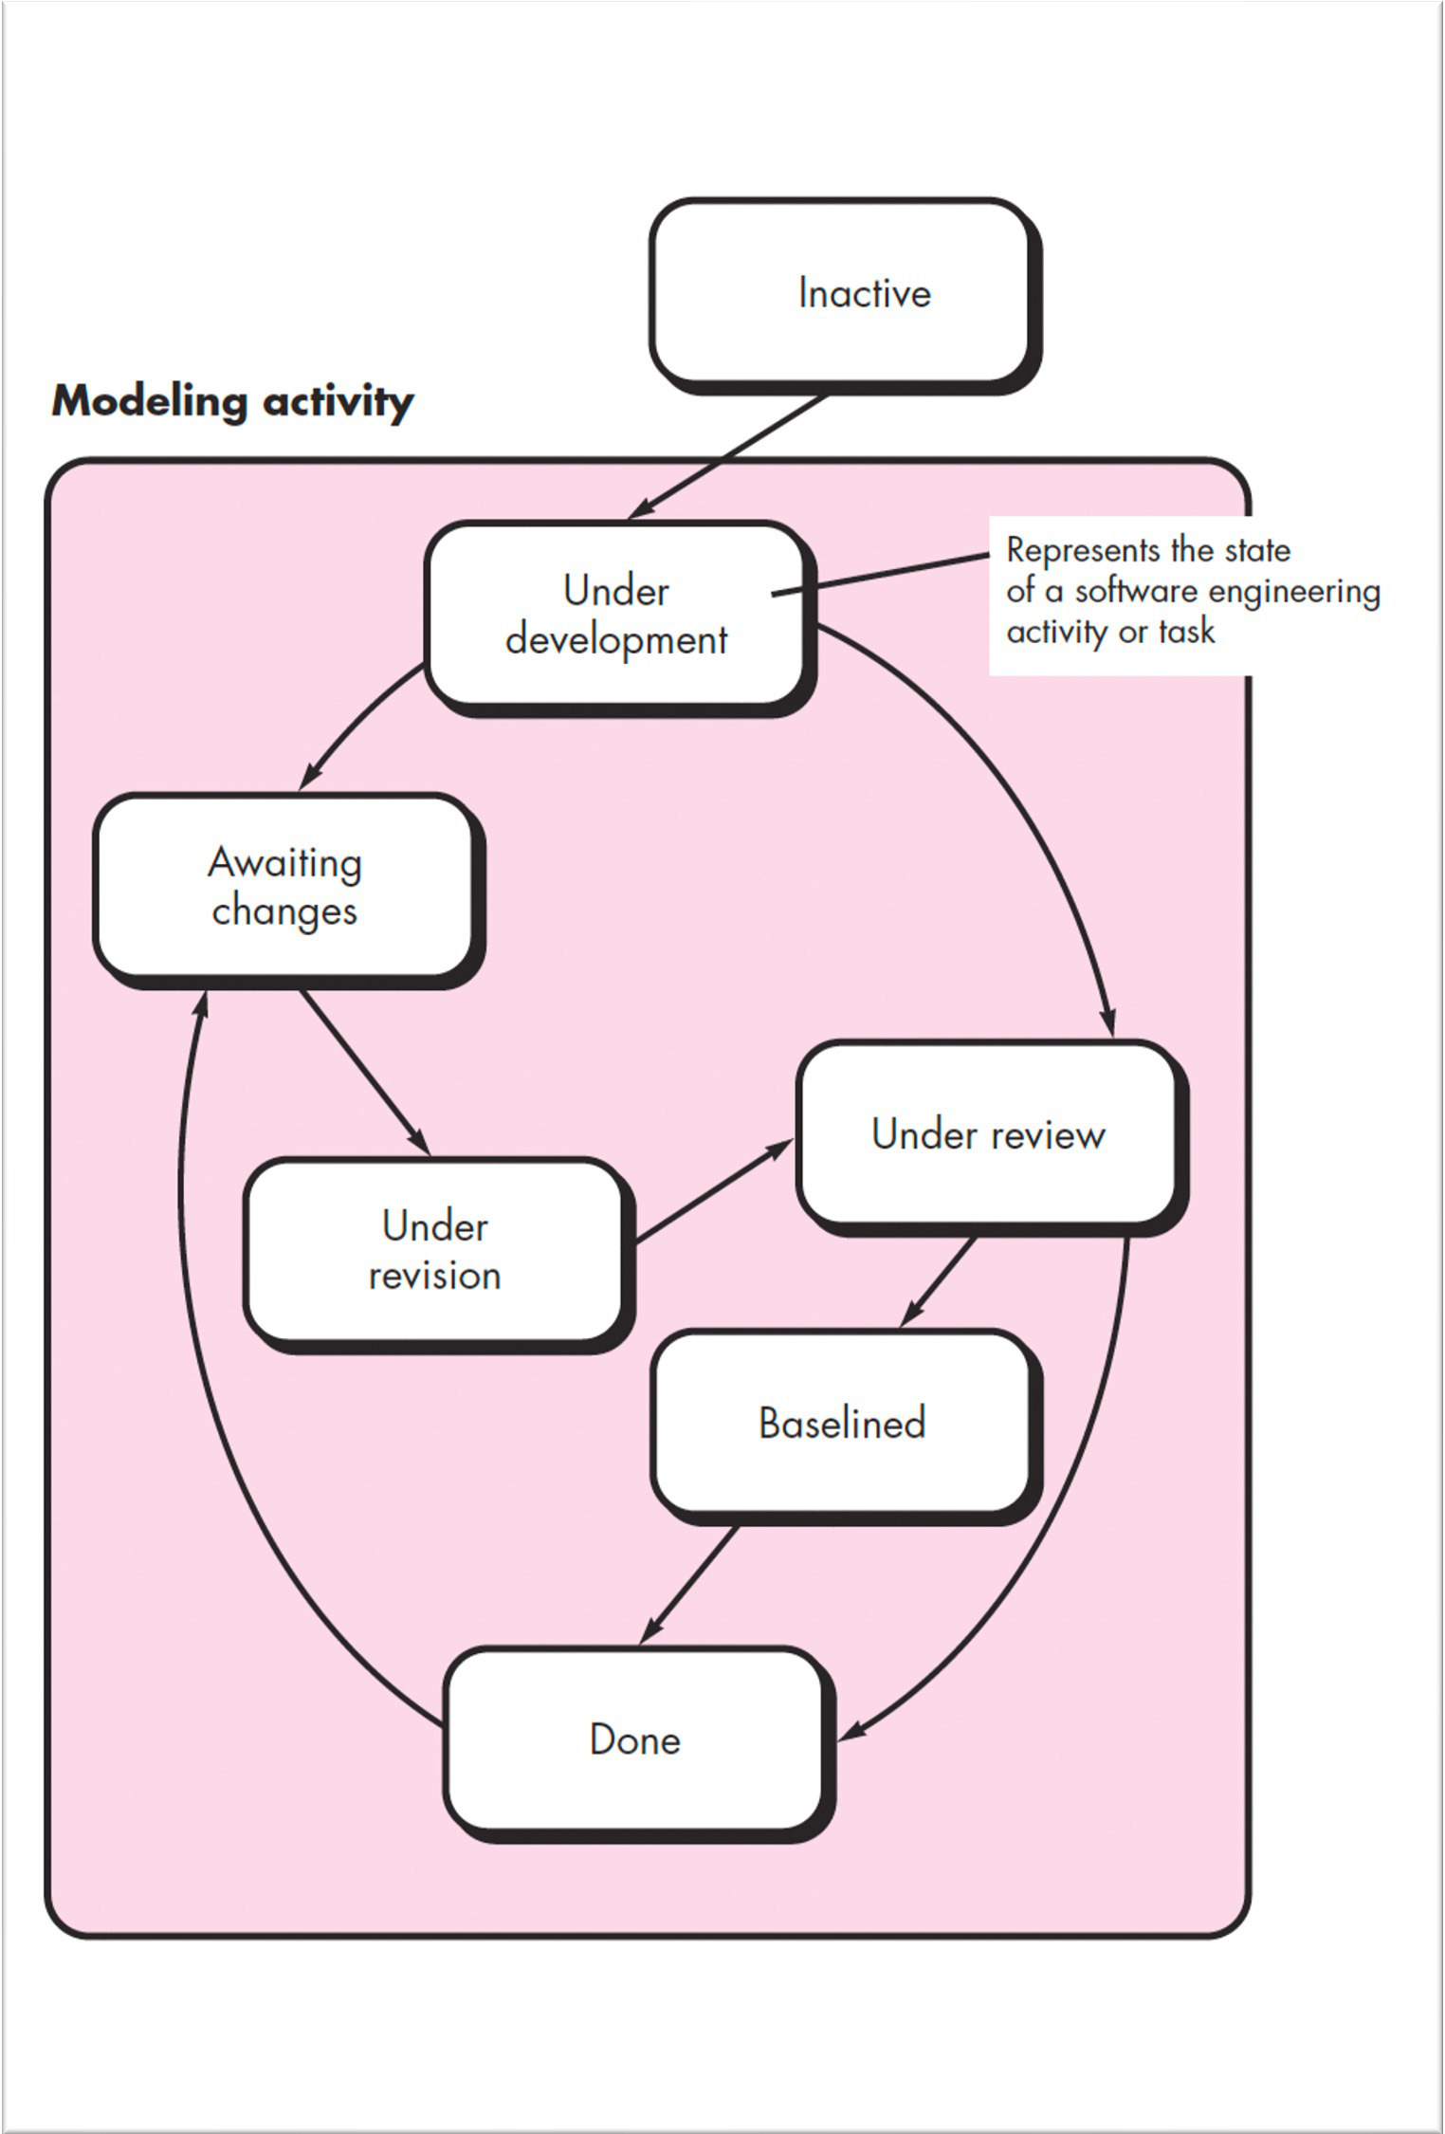
29
z
Concurrent
Developmental
Model
The concurrent development
model allows a software team
to
represent iterative and concurrent
elements of any of the process models already described

Slide 30
30
z
Concurrent
Developmental
Model
§
A schematic representation of the
modelling activity using a concurrent
modelling approach.
The activity may be in any one of the
states noted at any given time.
Similarly, other activities, actions, or
tasks can be represented in an
analogous manner.
All software engineering activities
exist concurrently but reside in
different states.
§
§
§

Slide 31
31
z
Concurrent Developmental Model
§ For example, early in a project the communication activity has
completed its first iteration and exists in the awaiting changes
state.
§ The modelling activity which existed in the inactive state while
initial communication was completed, now makes a transition
into the under development state.
§ If, however, the customer indicates that changes in requirements
must be made, the modelling activity moves from the under
development state into the awaiting changes state.

Slide 32
32
z
Concurrent Developmental Model
§ Concurrent modelling defines a series of events that will trigger
transitions from state to state for each of the software engineering activities, actions, or tasks.
§ For example, during early stages of design an inconsistency in
the requirements model is uncovered.
§ This generates the event analysis model correction, which will
trigger the requirements analysis action from the done state into the awaiting changes state.

Slide 33
33
z
Concurrent Developmental Model
§ Concurrent modelling is applicable to all types of software
development and provides an accurate picture of the current state of a project.
§ Rather than confining software engineering activities, actions,
and tasks to a sequence of events, it defines a process network.
§ Each activity, action, or task on the network exists simultaneously with other activities, actions, or tasks.
§ Events generated at one point in the process network trigger
transitions among the states.

Slide 34
34
z
Exercise
§ Try to develop a set of actions for the communication activity.
Select one action and define a task set for it.
§ Provide three examples of software projects that would be
amenable to the each of the process models discussed. Be specific

Slide 35
35
Any Questions?
The End
z

